Slide 1



The Rise of
AI

Slide 2

Topics Covered
ARTIFICIAL
INTELLIGENCE
Introduction
Types of AI
Advantages/ disadvantages
The future of AI
Conclusion

Slide 3
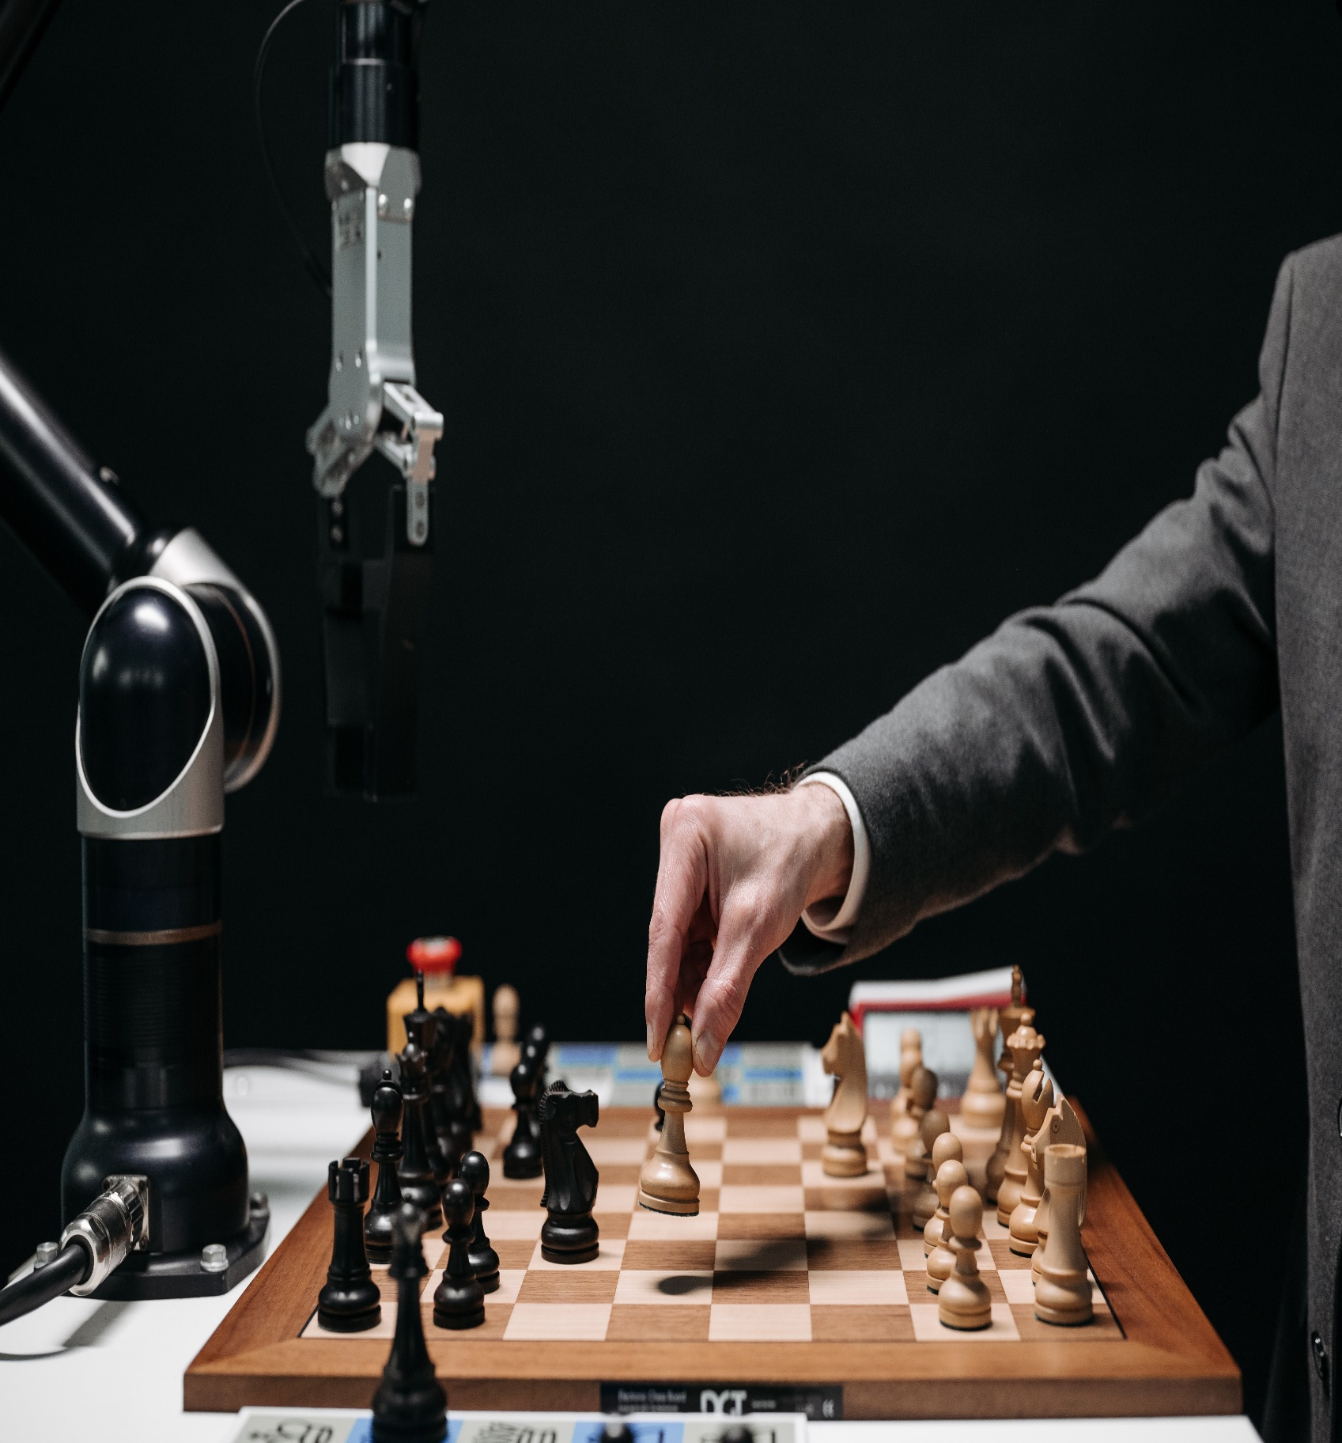
Introduction to AI
The stimulation of human intelligence in machines that are programmed to think and act like humans,
Used in wide range of applications like self driving cars and virtual assistants,
Can perform tasks that require human intelligence like decision making, problem solving, learning, reasoning, etc.

Slide 4


Types of AI
Narrow/ Weak AI: designed to perform specific tasks such as speech recognition, facial recognition and language recognition
General AI: Can perform any task a human can do
Super AI: can surpass human intelligence and can solve problems that are beyond human comprehension

Slide 5

"Artificial intelligence will reach human levels by around 2029. Follow that out further to, say, 2045, we will have multiplied the intelligence, the human biological machine intelligence of our civilization a billion-fold."
— Ray Kurzweil, Inventor and Futurist

Slide 6
Advantages of AI
Increased Efficiency
Cost Savings
Improved accuracy
Consistency
Reduced Error

Slide 7
Disadvantages of AI
Job Loss
Potential misuse
Over reliance on machines

Slide 8
THE FUTURE OF AI
Is expected to bring greater automation in industries such as transportation, manufacturing, etc.
Is expected to have significant impacts on healthcare, such as improving diagnostics, personalized medication and drug discovery
Is expected to improve significantly in the upcoming years
Advancement in self driving cars

Slide 9
CONCLUSION
AI is a powerful tool that can bring significant benefits for society and the economy with proper planning and consideration,
It has the potential to drive innovation, improve productivity and enhance our quality of life.

Slide 10
Thank you!

